Slide 1
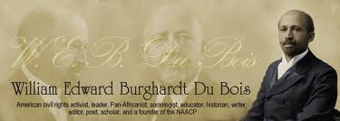
How Dr. W. E. B. DuBois fought the box and became a model for the freedom struggle
(A close reading of an important essay)

Slide 2
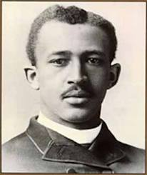
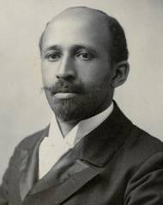
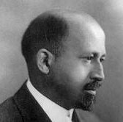
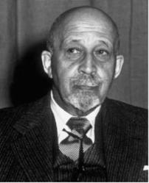
“One ever feels his twoness, -- an American, a Negro; two souls, two thoughts, two unreconciled strivings; two warring ideals in one dark body, whose strength alone keeps it from being torn asunder.”
“There are certain books in the world which every searcher for truth must know: the Bible, the Critique of Pure Reason, the Origin of Species, and Karl Marx's Capital.”
W. E. B. DuBois
1868 - 1963
“But we do not merely protest; we make renewed demand for freedom in that vast kingdom of the human spirit where freedom has ever had the right to dwell: the expressing of thought to unstuffed ears; the dreaming of dreams by untwisted souls.”
“The cost of liberty is less than the price of repression.”

Slide 3
The context for the essay by DuBois written in 1944
Global economic crisis
1929 stock market crash
Rise of Fascism
1933 Hitler appointed
Chancellor of Germany
Lynching in the US South
1892-1951 at least one official
lynching a year

Slide 5
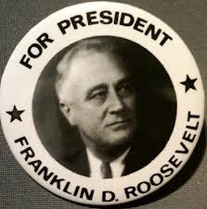
1941 State of the Union address
In the future days, which we seek to make secure, we look forward to a world founded upon four essential human freedoms. The first is freedom of speech and expression—everywhere in the world. The second is freedom of every person to worship God in his own way—everywhere in the world. The third is freedom from want—which, translated into world terms, means economic understandings which will secure to every nation a healthy peacetime life for its inhabitants—everywhere in the world. The fourth is freedom from fear—which, translated into world terms, means a world-wide reduction of armaments to such a point and in such a thorough fashion that no nation will be in a position to commit an act of physical aggression against any neighbor—anywhere in the world. That is no vision of a distant millennium. It is a definite basis for a kind of world attainable in our own time and generation.

Slide 6
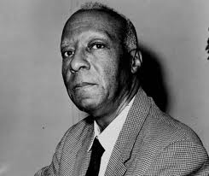
A Philip Randolph 1889-1979
1941
March on Washington threat
Executive Order 8802
The President's Committee
on Fair Employment Practice

Slide 7
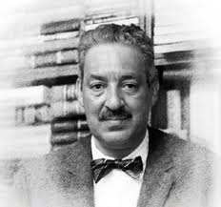
Thurgood Marshall 1908 - 1993
1954
Brown vs Board of Education
Massive movement for integrated
Quality education

Slide 8
1944
http://www.webdubois.org/dbMyEvolvingPrgm.html

Slide 9
Key questions to guide us in reading this essay
How did DuBois analyze the box?
How did DuBois live and struggle in the box?
How did DuBois struggle out the box?
How did DuBois fight for a new box?

Slide 10
DuBois has a basic view “in the box.”
=
“By ‘Freedom’ for Negroes, I meant
and still mean, full economic, political
and social equality with American
citizens, in thought, expression, and
action, with no discrimination based
on race or color.” (paragraph 100)

Slide 11
DuBois defines three stages of his work.
“1885 – 1910 The truth shall make ye free.” (122)
“1900 – 1930 United Action on the part of thinking Americans, white and Black, to force the truth concerning Negroes to the attention of the nation.” (124)
“1928 – 1944 Scientific investigation and organized action among Negroes, in close, co-operation, to secure the survival of the Negro race, until the cultural development of America and the world is willing to recognize Negro freedom.” (126)

Slide 12
“I began with a bibliography of Nat Turner and ended with a history of the suppression of the African Slave Trade to America; neither needed to be done again at least in my day. Thus in my quest for basic knowledge with which to help guide the American Negro, I came to the study of sociology, by way of philosophy and history rather than by physics and biology, which was the current approach; moreover at that day, Harvard recognized no "science" of sociology and for my doctorate, after hesitating between history and economics, I chose history. On the other hand, psychology, hovering then at the threshold of experiment under Münsterberg, soon took a new orientation which I could understand from the beginning. “ (26)
DuBois - a Sociologist
“I saw the action of physical law in the actions of men; but I saw more than that: I saw rhythms and tendencies; coincidences and probabilities; and I saw that, which for want of any other word, I must in accord with the strict tenets of Science, call Chance. I went forward to build a sociology, which I conceived of as the attempt to measure the element of Chance in human conduct. This was the Jamesian pragmatism, applied not simply to ethics, but to all human action, beyond what seemed to me, increasingly, the distinct limits of physical law. “ (75)

Slide 13
Theoretical orientation is critical
“It was of course crazy for me to dream that America, in the dawn of the Twentieth Century, with Colonial Imperialism, based on the suppression of colored folk, at its zenith, would encourage, much less adequately finance, such a program at a Negro college under Negro scholars. My faith in its success was based on the firm belief that race prejudice was based on widespread ignorance. My long-term remedy was Truth: carefully gathered scientific proof that neither color nor race determined the limits of a man's capacity or desert. I was not at the time sufficiently Freudian to understand how little human action is based on reason; nor did I know Karl Marx well enough to appreciate the economic foundations of human history.” (51)

Slide 14
DuBois defines the 20th century box:
Structure
“For the American Negro, the last decade of the 19th, and the first decade of the 20th Centuries were more critical than the Reconstruction years of 1868 to 1876. Yet they have received but slight attention from historians and social students. They are usually interpreted in terms of personalities, and without regard to the great social forces that were developing. This was the age of triumph for Big Business, for Industry, consolidated and organized on a world-wide scale, and run by white capital with colored labor. The southern United States was one of the most promising fields for this development, with invaluable staple crops, with a mass of cheap and potentially efficient labor, with unlimited natural power and use of unequalled technique, and with a transportation system reaching all the markets of the world.” (54)

Slide 15
DuBois defines the 20th century box:
Policy
“…a new racial philosophy for the South was evolved. This philosophy seemed to say that the attempt to over-educate a "child race" by furnishing chiefly college training to its promising young people, must be discouraged; the Negro must be taught to accept what the whites were willing to offer him; in a world ruled by white people and destined so to be ruled, the place of Negroes must be that of an humble, patient, hard-working group of laborers, whose ultimate destiny would be determined by their white employers. Meantime, the South must have education on a broad and increasing basis, but primarily for whites; for Negroes, education, for the present, should be confined increasingly to elementary instruction, and more especially to training in farming and industry, calculated to make the mass of Negroes laborers contented with their lot and tractable.” (56)

Slide 16
The promise of social science
“It was a hard job, but I completed it by the Spring of 1898 and published it a year later, under the auspices of the University, as The Philadelphia Negro … First of all I became painfully aware that merely being born in a group, does not necessarily make one possessed of complete knowledge concerning it. I had learned far more from Philadelphia Negroes than I had taught them concerning the Negro Problem. Before the American Academy, affiliated with the University, I laid down in public session in 1899, a broad program of scientific attack on this problem, by systematic and continuous study; and I appealed to Harvard, Columbia and Pennsylvania, to take up the work.” (40)

Slide 17
DuBois launched a scientific program
of study at Atlanta University
First 10 conferences
Plan for annual conference s (1914)
“1896, Mortality among Negroes in Cities 1897, Social and Physical Condition of Negroes in Cities 1898, Some Efforts of Negroes for Social Betterment 1899, The Negro in Business 1900, The College-bred Negro 1901, The Negro Common School 1902, The Negro Artisan 1903, The Negro Church 1904, Notes on Negro Crime 1905, A Select Bibliography of the American Negro” (45)
”1. Population: Distribution and Growth 2. Biology: Health and Physique 3. Socialization: Family, Group and Class 4. Cultural Patterns: Morals and Manners 5. Education 6. Religion and the Church 7. Crime 8. Law and Government 9. Literature and Art 10. Summary and Bibliography” (49)
…one box at a time…

Slide 18
“Between 1935 and 1941, I wrote and published three volumes: a study of the Negro in Reconstruction; a study of the black race in history and an autobiographical sketch of my concept of the American race problem. To these I was anxious to add an Encyclopaedia of the Negro. I had been chosen in 1934 to act as editor-in-chief of the project of the Phelps-Stokes Fund to prepare and publish such a work. I spent nearly ten years of intermittent effort on this project and secured co-operation from many scholars, white and black, in America, Europe and Africa. But the necessary funds could not be secured. Perhaps again it was too soon to expect large aid for so ambitious a project, built mainly on Negro scholarship. Nevertheless, a preliminary volume summarizing this effort will be published in 1940.” (91)

Slide 19
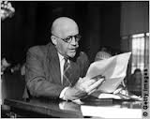
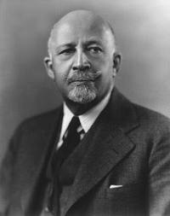
In sum…
The box could be studied
Truth does not stand alone
Reason confronts the irrational
Morality must confront power
Our goal is freedom, equality

Slide 20
First stage of “in the box”: Youth
“I had almost no experience of segregation or color discrimination. My schoolmates were invariably white; I joined quite naturally all games, excursions, church festivals; recreations like coasting, skating and ball-games. I was in and out of the homes of nearly all my mates, and ate and played with them. I was a boy unconscious of color discrimination in any obvious and specific way.” (4)
“The secret of life and the loosing of the color bar, then, lay in excellence, in accomplishment; if others of my family, of my colored kin, had stayed in school, instead of quitting early for small jobs, they could have risen to equal whites. On this my mother quietly insisted. There was no real discrimination on account of color—it was all a matter of ability and hard work.” (6)

Slide 21
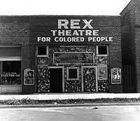
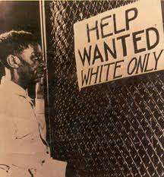
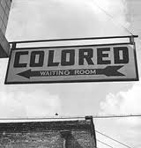
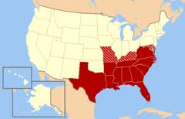
Out the box…
“Thus in the Fall of 1885 and at the age of seventeen, I was tossed boldly into the "Negro Problem." From a section and circumstances where the status of me and my folk could be rationalized as the result of poverty and limited training, and settled essentially by schooling and hard effort, I suddenly came to a region where the world was split into white and black halves, and where the darker half was held back by race prejudice and legal bonds, as well as by deep ignorance and dire poverty.
But facing this was not a little lost group, but a world in size and a civilization in potentiality. Into this world I leapt with provincial enthusiasm. A new loyalty and allegiance replaced my Americanism: henceforward I was a Negro.” (14-15)

Slide 22
Role of the talented tenth:
“I replaced my hitherto egocentric world by a world centering and whirling about my race in America. To this group I transferred my plan of study and accomplishment. Through the leadership of men like me and my fellows, we were going to have these enslaved Israelites out of the still enduring bondage in short order. It was a battle which might conceivably call for force, but I could think it confidently through mainly as a battle of wits; of knowledge and deed, which by sheer reason and desert, must eventually overwhelm the forces of hate, ignorance and reaction.” (17)

Slide 23
Back in the box but not all the way
“Nevertheless my friends and companions were taken from the colored students of Harvard and neighboring institutions, and the colored folk of Boston and other cities. With them I led a happy and inspiring life. There were among them many educated and well-to-do folk; many young people studying or planning to study; many charming young women. We met and ate, danced and argued and planned a new world. I was exceptional among them, in my ideas on voluntary race segregation; they for the most part saw salvation only in integration at the earliest moment and on almost any terms in white culture; I was firm in my criticism of white folk and in my more or less complete dream of a Negro self-sufficient culture even in America.” (28)

Slide 24
Struggle inside the box…
“As I have said elsewhere, the National Association for the Advancement of Colored People ‘proved between 1910 and the World War, one of the most effective organizations of the liberal spirit and the fight for social progress which the Negro race in America has known.’ It fought frankly to make Negroes ‘politically free from disfranchisement; legally free from caste and socially free from insult.’ It established the validity of the Fifteenth Amendment, the unconstitutionality of the ‘Grandfather Clause,’ and the illegality of residential segregation. It reduced lynching from two hundred and thirty-five victims a year to a half dozen. But it did not and could not settle the ‘Negro Problem.’” (69)
“This new field of endeavor represented a distinct break from my previous purely scientific program. While ‘research’ was still among my duties, there were in fact no funds for such work. My chief efforts were devoted to editing and publishing the Crisis, which I founded on my own responsibility, and over the protests of many of my associates. With the Crisis, I essayed a new role of interpreting to the world the hindrances and aspirations of American Negroes. My older program appeared only as I supported my contentions with facts from current reports and observation or historic reference; my writing was reinforced by lecturing, and my facts increased by travel. “ (70)

Slide 25
Struggle out the box…
“The Pan-African congresses which I called in 1919, 1921 and 1923, were chiefly memorable for the excitement and opposition which they caused among the colonial imperialists. Scarcely a prominent newspaper in Europe but used them as a text of warning, and persisted in coupling them with the demagogic ‘Garvey Movement,’ then in its prime, as a warning for colonial governments to clamp down on colonial unrest. My only important action in this time, was a first trip to Africa, almost by accident, and a vaster conception of the role of black men in the future of civilization.” (80)
“From 1910 to 1920, I had followed the path of sociology as an inseparable part of social reform, and social uplift as a method of scientific social investigation; then, in practice, I had conceived an interracial culture as superseding as our goal, a purely American culture; before I had conceived a program for this path, and after throes of bitter racial strife, I had emerged with a program of Pan-Africanism, as organized protection of the Negro world led by American Negroes. But American Negroes were not interested.” (82)

Slide 26
DuBois said capitalism is not the answer
“I saw of course but little of Russia in one short month. I came to no conclusions as to whether the particular form of the Russian state was permanent or a passing phase…But of one thing I am certain: I believe in the dictum of Karl Marx, that the economic foundation of a nation is widely decisive for its politics, its art and its culture. I saw clearly, when I left Russia, that our American Negro belief that the right to vote would give us work and decent wage; would abolish our illiteracy and decrease our sickness and crime, was justified only in part; that on the contrary, until we were able to earn a decent, independent living, we would never be allowed to cast a free ballot; that poverty caused our ignorance, sickness and crime; and that poverty was not our fault but our misfortune, the result and aim of our segregation and color caste; that the solution of letting a few of our capitalists share with whites in the exploitation of our masses, would never be a solution of our problem, but the forging of eternal chains, as Modern India knows to its sorrow.” (85)

Slide 27
DuBois lived all forms of struggle
Inside the box the fight is against all
forms of injustice – we have no choice.
Out the box we have to consider the possibility
of an alternative – we have no choice.
Whether in or out of the box, we have to consider
the strategy of fighting to replace the box with
a new box – we have no choice.
Every form of struggle is necessary, but only sufficient
when they converge into one giant assault on the system

